Slide 1
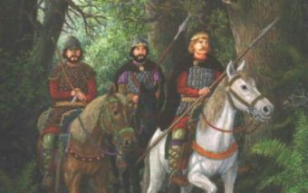
„Lech, Czech and Rus”
Polish legend

Slide 2
Centuries ago, when the Europe was developing and dividing into countries, there lived three brothers of Slavic origin: Czech, Lech and Rus. They wandered through a vast territory between two rivers: Odra to the West, and Dniepr to the East side. The brothers traversed through vast fields and woods. Their journey was not an easy one, because they had to stand face to face with the uninviting side of nature and ferocious, wild animals. The brothers wandered, followed by their people to whom each was the leader. They all sought the best place to settle down, an area that would become their home and promise well-being and development.

Slide 3
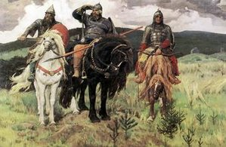

Slide 4
The wanderers shared the same origin, so they understood each other very well which made simpler to travel, but they knew that eventually they would have to separate and choose different paths. Despite the companionship, which made the journey easier, wandering for that long was still a challenge. Among the travellers there were children and elderly people who straggled to keep up with the rest. Despite the difficulties, neither of the brothers gave up on seeking the desired land and insisted on continuing the journey. The brothers knew that a lot of lives depended on that one simple decision, and that it wouldn’t be wise to give up the search that quickly. They waited for special signs suggesting that a particular area is worth settling down.

Slide 5
They continued their journey and their path went through wide fields, thick forests, between banks of wide rivers and next to beautiful lakes. The journey lasted long and they started to lose hope to find a fine place to stay. One day the brothers stopped on a beautiful meadow near the lake. They sat under an ancient, mighty oak tree. It was summer and the sunlight was scorching the land. The people needed to rest. The brothers rested in the shadow of the tree and discussed their journey. The day was peaceful and the brothers decided to take a short nap. Suddenly, they heard a noise among the tree’s numerous branches and twigs covered with green leaves. The noise became louder, and louder. Unexpectedly, a majestic and dignified bird caught their eyes. It was gazing down, straight into their eyes from its nest and there was something piercing and frightening in the way it look at them.

Slide 6
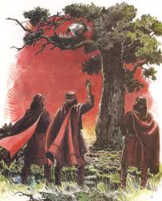
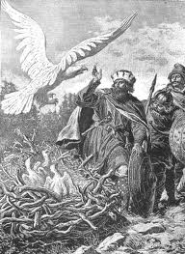

Slide 7
It was the first time the brothers saw a bird that majestic, beautiful and proud. It was a white eagle. They had seen eagles before, but never that big. The creature impressed the brothers, especially Lech, who could not stop staring at it. The bird, reassured of being safe, turned its eyes from the brothers and started to look around. Captivated by the bird’s figure set against the green leaves, Lech followed the bird and looked around as well. He admitted that the landscape was remarkable and he understood what was the bird looking at. This surely must have been the white eagle’s kingdom. If the eagle had chosen this, it must have been the sign Lech had awaited. He felt it. “The eagle cannot be mistaken” – Lech thought – “he will stay here with his people. The green valley, fertile soil, thick forests inhabited by animals and full of bushes with blueberries, mushrooms; the lake full of fish; the area was full of everything. Lech made the decision: here he will settle, here he will build his country.

Slide 8
Wandering separately was harder for each of the two tribes and Lech struggled to build his estate. Standing under the oak tree, he saw his two brothers leaving him behind. He didn’t feel solitude though, and he was quite right. The white eagle was looking down at him. It didn’t have any intention of attacking Lech. It spread its broad winds, flapped it and flew off. Many times it came back and circled above the settlement only to witness the beauty of it. Lech’s people were unfamiliar with the feeling of hunger, insecurity or unhappiness.

Slide 9
Lech knew he had made a wide decision. The settlement grew only bigger and with each day it was more beautiful. Up from the sky it resembled the nest Lech saw on the oak tree’s branch, the white eagle’s nest. The settlement was named after the nest and eventually became the capital city of Poland. The figure of the white eagle was never to be forgotten, so the people decided to put it on the national coat of arms of Poland.

Slide 10
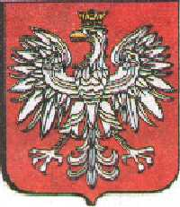
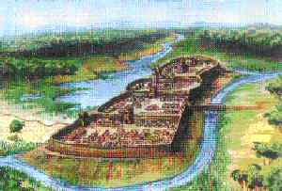
Polish emblem
Gniezno - the first capital of Poland

Slide 11
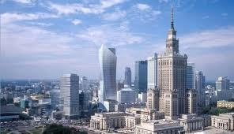
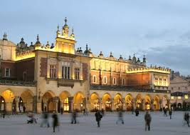
Polish towns
Warsaw
Krakow

Slide 12
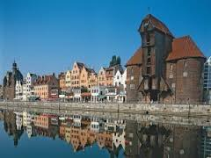
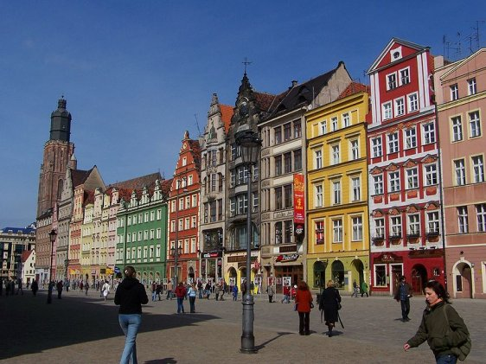
Gdansk
Wroclaw

Slide 13
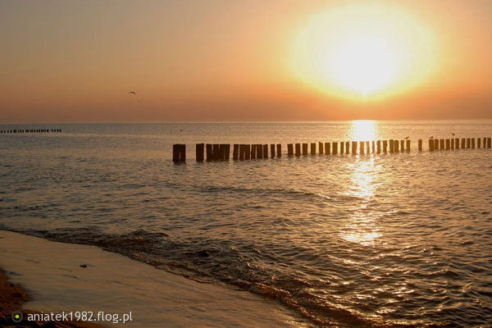
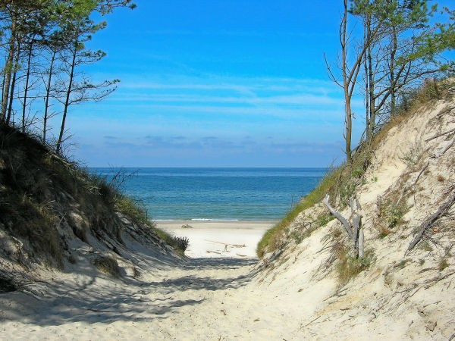
Baltic Sea

Slide 14
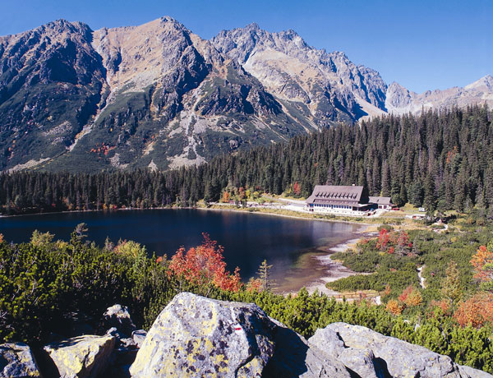
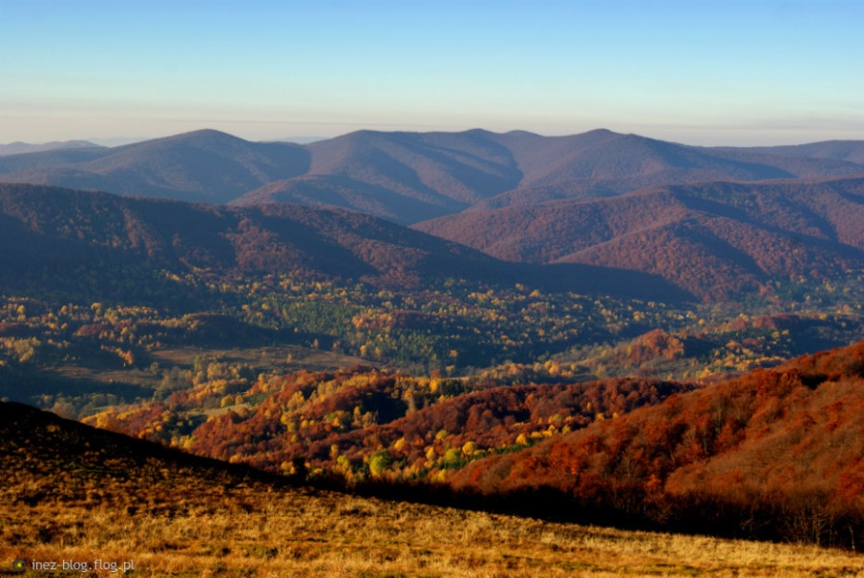
Polish mountains
Tatry
Bieszczady

Slide 15
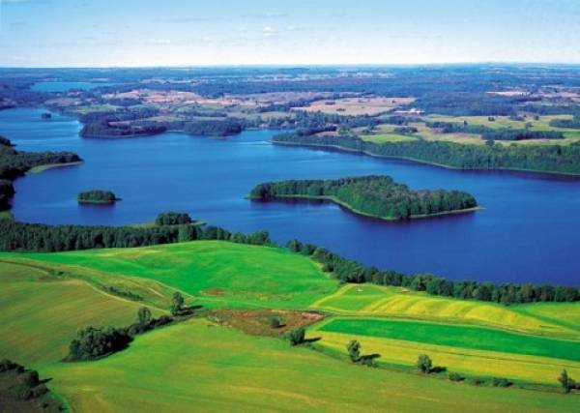
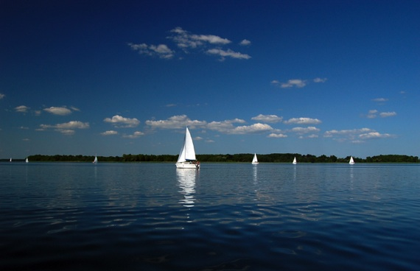
Polish lakes

