Slide 1
Welsh Myths and Legends
Victoria English
Independent Living Skills Tutor
Coleg Gwent

Slide 2
Wales is famous for having old legends and folklore – these stories give us an insight into the lives and beliefs of people who lived here hundreds and hundreds of years ago.

Slide 3
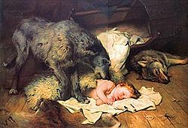
Beddgelert

Slide 4
Beddgelert
The Welsh Prince Llewellyn had a favourite hound, Gelert, given to him by his father-in-law, King John
The Prince trusted Gelert to watch the cradle of his baby son whilst he was away from his castle
One day, on his return, to his intense horror, he saw the baby cradle empty and upset, the clothes dabbled with blood, and Gelert’s mouth dripping with gore. Hastily thinking that the hound had proved unfaithful, had fallen on the child and devoured it. In his rage the prince drew his sword and slew the dog

Slide 5
Beddgelert
Shortly after the cry of the babe from behind the cradle showed him that the child was uninjured, and, on looking farther, Llewellyn discovered the body of a huge wolf, which had entered the house to seize and devour the child, but which had been kept off and killed by the brave dog Gelert
Too late, Llewellyn learned that brave Gelert had stayed behind to guard the child and had fought and slain the wolf that had tried to destroy Llewellyn's heir

Slide 6
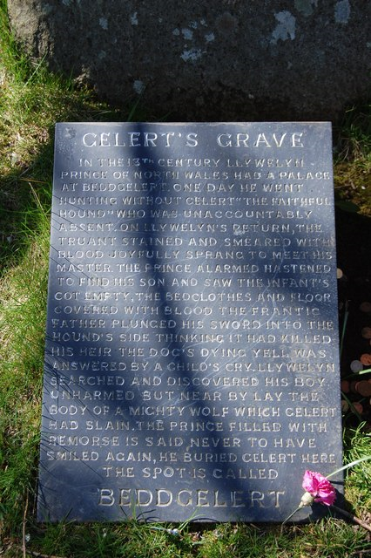
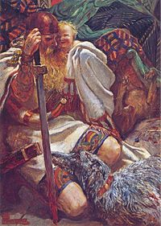
Beddgelert
In vain Llewellyn could not bring his faithful dog to life again. So he buried him outside the castle walls within sight of the great mountain of Snowdon, in North Wales, where every passer-by might see his grave, and raised over it a great cairn of stones
And to this day the place is called Bedd Gelert, or the Grave of Gelert

Slide 7
LEGENDS WALES
http://myths.e2bn.org/mythsandlegends/playstory760-the-story-of-gelert.html

Slide 8
Welsh flag

Slide 9
Welsh flag
The flag is known as Y Ddraig Goch, meaning “The Red Dragon"
The flag incorporates the Red Dragon of Cadwaladr, King of Gwenedd, along with the Tudor colours of green and white. It was used by Henry VII at the Battle of Bosworth Field in 1485
Long ago there was a King in Wales who wanted to build a castle. At night his servants built a wall, but in the morning it was ruined. Next night they built the wall again

Slide 10
Welsh flag
The wall was built during the day and ruined at night three times. The King was upset and thought “What is wrong? What is happening? Why can’t I build a castle?”
The King asked for help and sent a servant to find a wise boy (Merlin?) who could explain why the castle was ruined every night. The wise boy knew how to stop it and told the servant to go find a young boy who had no father and take him to the King
There was a lake near the castle. The boy told the King to look under the lake and he would discover why his castle was ruined

Slide 11
Welsh flag
The King and his men went under the lake. There they saw two dragons, a red one and a white one. They were fighting every night and the ground was shaking so strong that the castle was ruined
Some time passed and the red dragon finally won and slayed the white dragon. The King could now build his castle. He was very happy and the red dragon lived happily ever after in Wales
Most Welsh people will think of the story of the red dragon fighting the white dragon as the Welsh defeating the English!

Slide 12
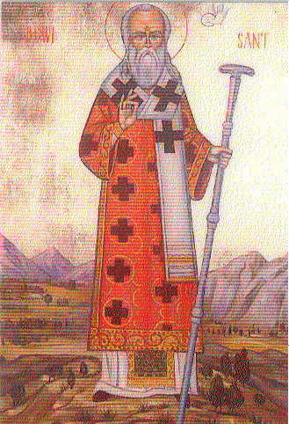
Saint David

Slide 13
Saint David
St David (Dewi Sant) is the patron saint of Wales
Dewi was a Celtic monk, abbot and bishop, who lived in the sixth century
He was a very gentle person who lived a simple life mostly eating bread and herbs, although it is known that he was tall and physically strong

Slide 14
Saint David
The most well-known story regarding Dewi's life is when they were to decide whether Dewi was to be Archbishop.
A great crowd gathered at the synod, and when Dewi stood up to speak, one of the congregation shouted, 'We won't be able to see or hear him'. At that instant the ground rose till everyone could see and hear Dewi!
Unsurprisingly, it was decided, very shortly afterwards, that Dewi would be the Archbishop

Slide 15
Saint David
On a Tuesday, the first day of March, in the year 589, Dewi passed away and his monastery is said to have been 'filled with angels as his soul was received’
Dewi's body was buried in the grounds of his own monastery, where the Cathedral of St David in West Wales now stands
David was canonised as a Saint in 1120 by Pope Callactus and for this he was declared the Patron Saint of Wales
St Davids Day is celebrated throughout Wales on March 1st every year

Slide 16
Diolch yn fawr
Thank You
Victoria English
Independent Living Skills Tutor
Coleg Gwent

Slide 17
