Slide 1
COMENIUS 23-3-2014- 27-3-2014
HUNGARY

Slide 2
Miskolc

Slide 3
HUNGARY
Hungary is a landlocked state with many neighbours – Slovakia, Ukraine, Romania, Serbia, Croatia, Slovenia and Austria. It is mostly flat, with low mountains in the north.
Lake Balaton, a popular tourist centre, is the largest lake in central Europe.

Slide 4
HUNGARY
The ancestors of ethnic Hungarians were the Magyar tribes, who moved into the Carpathian Basin in 896. Hungary became a Christian kingdom under St Stephen in the year 1000.
The Hungarian language is unlike any of the country’s neighbouring languages and is only distantly related to Finnish and Estonian.
The capital city, Budapest, was originally was two separate cities: Buda and Pest. It straddles the River Danube, is rich in history and culture and famed for its curative springs. Hungary has a single-chamber parliament or national assembly whose 386 members are elected by voters every four years.

Slide 5
Cuisine
Hungary is known for its excellent food. In the old days, fatty meat, overcooked fish and soups were favoured, because times were hard. But today, people can make more tasty food. Pork is the meat of choice in Hungary. Some traditional dishes are: goulash, which is a type of thickened beef soup; halaszle, which is a spicy fish soup; palacsinta, which is stuffed crepes.

Slide 6
Famous people:
Albert Albert Szent-Györgyi – who discovered Vitamin C Imre Kertész – writer and Nobel Prizewinner István Szabó – Oscar-winning film director

Slide 7
FACTS
Political system: Republic
Capital city: Budapest
Language: Hungarian
National day: 20 August – Feast of St Stephen n(founder of the state)
Total area: 93 000 km²
Population: 10.1 million
Currency: forint

Slide 8
How to say hello
How to say Hello: Szia

Slide 9
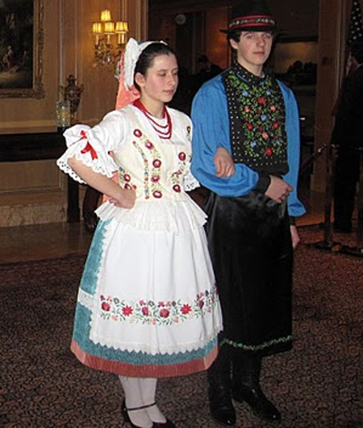
NATIONAL COSTUME
Richly embroidered aprons for the ladies and shirts for the gentlemen characterize these Hungarian folk costumes. The men wear pants tucked into their leather boots and hats, and the women wear different colored skirts and bright headdresses.

Slide 10
FESTIVALS
Carnival Season – Farsang – Costume parties and carnivals take place all month long to mark the end of winter, especially on the last Saturday in February. City festivities usually include carnival, parade and open-air music concert. A great celebration is held in Mohács called the ’Busójárás’. People dress up as scary animals, burn the winter away and dance. This tradition is similar to the Bulgarian tradicion called Kukiri and aims to scare away the bad spirits.
15th of March 1848 Revolution Day – The “Hungarian spring” – a fight for freedom against Habsburg domination which later led to war against Austria and its allies. Each year on March 15, the Hungarian tricolors of red, white, and green are prominently displayed all over the country.

Slide 11
FESTIVALS
20th of August St. Stephen’s Day – In the year of 1000, Hungary’s first king, the St Stephen, was crowned this day, and the Hungarian state was founded. Parades and music are among the festivities, and an impressive fireworks show is launched over the Danube at night.
23th of October 1956 Uprising Memorial Day This national holiday commemorates the outbreak of the people’s uprising against Soviet domination in 1956.

Slide 12
The School

Slide 13
Salon

Slide 14
Children's work

Slide 15
Making flowers

Slide 16
Classrooms

Slide 17
Hungarian Dance Show

Slide 18
Lessons

Slide 19
Lessons

Slide 20
Lessons

Slide 21
Places Visited

Slide 22
WORLDS BIGGEST BOOK

Slide 23
Chariot riding

Slide 24
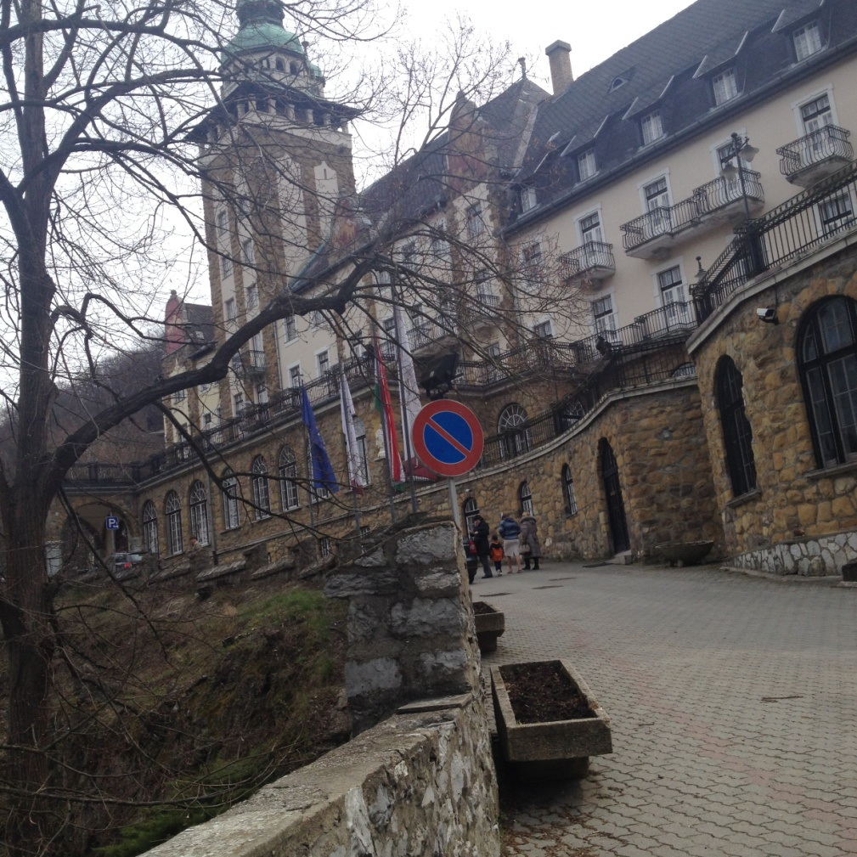
Lillafured

Slide 25
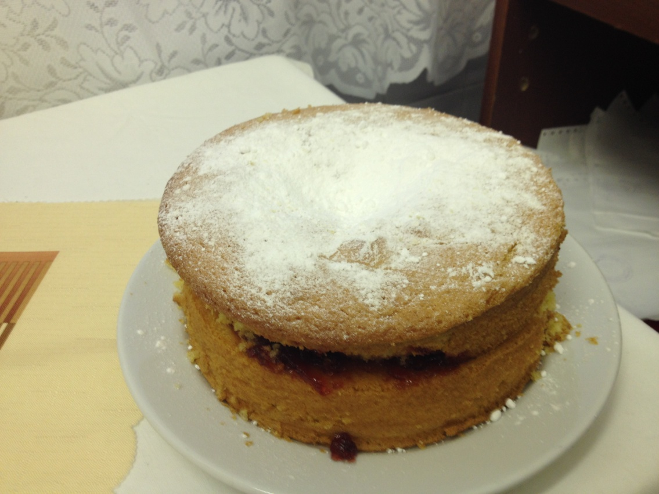
Our Flavors
We made desserts

